Slide 1
RESEARCH METHODOLOGY
Presentation by
Ms. N. Thamizhini
Assistant Professor
Department of English
Thiruvalluvar University
Serkkadu, Vellore-632115
Contact Mail ID: linitamil@gmail.com

Slide 2
IMPORTANT STEPS TO BE FOLLOWED
What is Research?
Objectives of Literary Research
Types of Research
Selecting a topic
Data collection-Using Library sources
Formulating the Research Problem
Plagiarism
Mechanics of writing
Format of the thesis

Slide 3
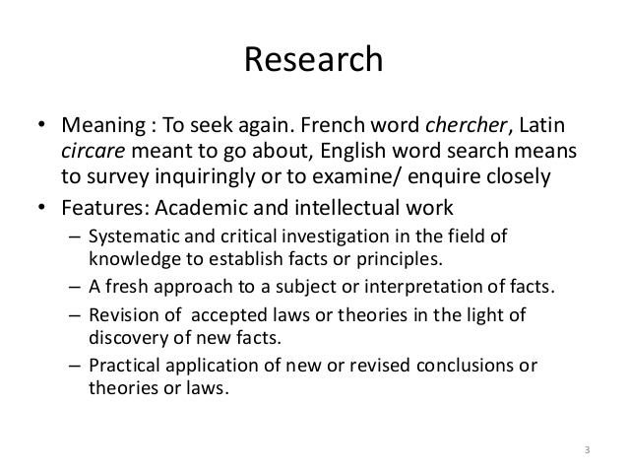

Slide 4
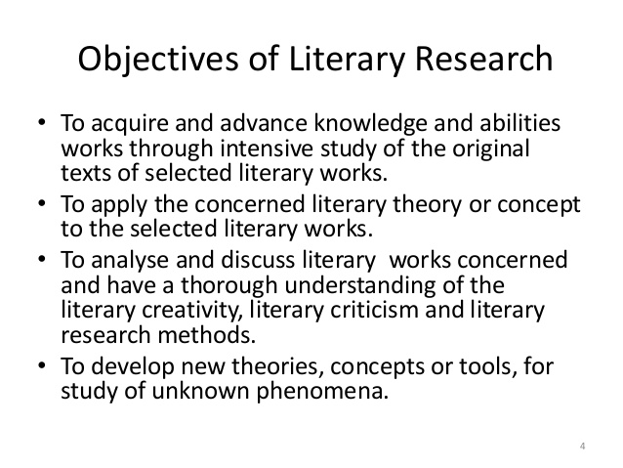

Slide 5
Types of Research Explorative : deals with existing problems will not provide conclusive results eg: Sociological issues Empirical: the record of one’s direct observations and experiences Will Provide Conclusive results eg: Scientific Research)

Slide 6
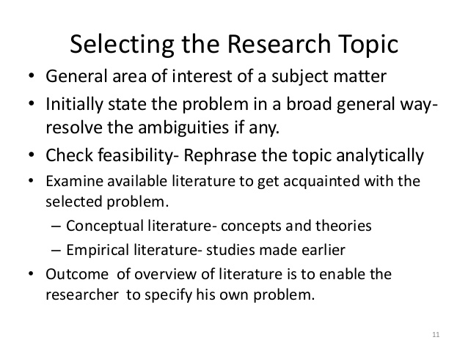

Slide 7
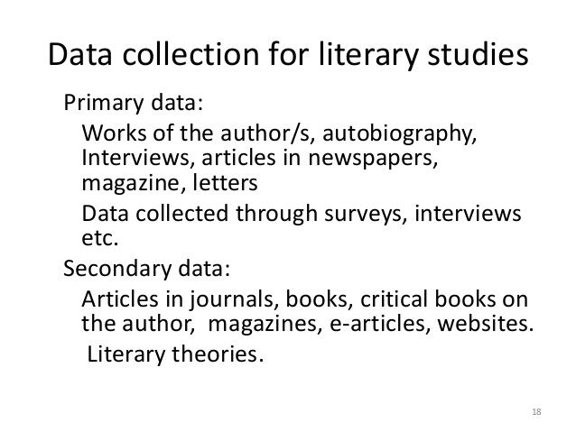

Slide 8
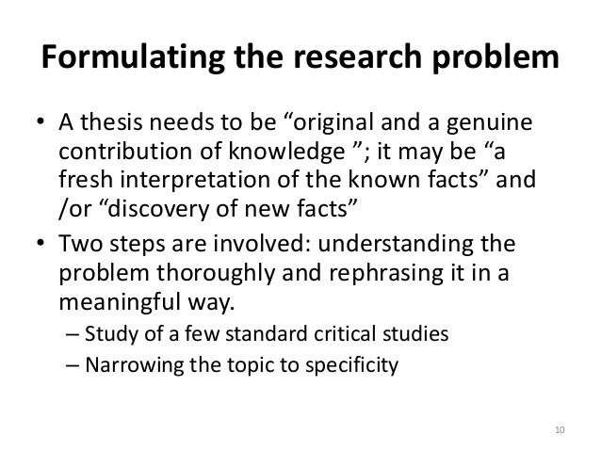

Slide 9
Plagiarism
Serious Offence
Intentional Plagiarism
Unintentional Plagiarism

Slide 10
Mechanics of Writing
Punctuation
Titles
Nouns
Numbers
Spelling
, / ./ :/ ;/- / ( ) /[ ] / ‘ ’/ “ ”

Slide 11
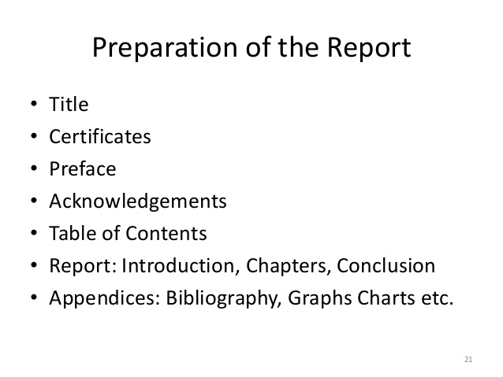

Slide 12
Bibliography
Bernard, Rita. Apartheid and Beyond : South African Writers and the Politics of place. Oxford : Oxford University Press, 2007.
Postel, Gitte. “The Diviner’s Task : The Confinement and Transformation Through Myth and Ritual in Gordimer’s The Conservationist”. Research in African Literatures. 38.4 (Oct-Dec 2007): 47-60. Print.
Toshiko, Sakamoto. “Black Women in Nadine Gordimer’s None to Accompany Me. Web. 11.9.2019 www.ccsu.edu/afstudy/upd8-2.html.7.2.2000. p 1.5
Parker, Kenneth. Ed. The South African Novel in English: Essays in Criticism and Society. London: The Macmillan Press LTD, 1978. Print.

